Slide 1
Towards a business plan : Ghana Medical Journal
Researchers without Borders – AJPP assignment
Annette Leeuwendal
Director, Journal Services STMJ
Elsevier Global Publishing Development
Email: a.leeuwendal@elsevier.com
Radarweg 29, 1043 NX Amsterdam, The Netherlands
November 16th, 2017 – Accra, Ghana
Notes:
The goal of this presentation is to provide a background on scholarly publishing and in particular the journal publishing cycle

Slide 2
Contents business review GMJ 2017
SUMMARY
1. International position of the journal
2. Stakeholder analysis
3. SWOT analyses
4. Summary of outcomes of the Author Survey
5. Best-fit scenario for further development
6. Financial outlook and recommendations
Appendices
  Job description Managing Editor-role (included)
  References and sources (included)
  Author Survey in full (included)
  Special issue guidelines and templates (sent separately as Word files)
  Best practice in Article Based Publishing (sent separately as Word files)
  Budgeting template (sent separately as an Excel-file)

Slide 3
Summary
Based on primary and secondary desk research as listed in the final appendix , I have conducted a business analysis during the last week of the AJPP assignment.
The attached slide deck summarizes the findings, and support further development of three key areas for GMJ:
►Stakeholder engagement strategy for each critical stakeholder group
►Content strategy addressing type of content, format and notification
►Operational effectivity for the infilling of editorial roles, manuscript workflow and business reporting.
Going forward, each of these strategies will require a succinct plan of action with timeliness and a dedicated budget.
My assignment at GMJ , as well as the workshops held at UCC, KNUST and UoG, have extended my understanding of the ongoing need for research-building activities as a prerequisite to publishing a successful research journal.

Slide 4
1. International position of the journal
The journal has seen an upwards trend in cite score since 2012 , although the contribution of seminal papers receiving many citations, has dropped since 2012.
A Field-weighted Citation Index of 1 is very acceptable for a journal with a predominantly national/regional readership.
Citation data from SCOPUS, as expressed in the Cite Score metric :
2015 data
Scopus CiteScore 2015,
1.02= Citation Count 2015 / Documents 2012 -through 2014* = 113 citations/111
articles Category : Medicine, 71st percentile
Journal ranking: # 446/1549 #446/ rank out of1549
2016 data: missing (inquiry made with Scopus team)
2017 data to date
0.50= Citation Count 2017/Documents 2014 -through 2016 = 55 citations /111 articles.1 1 Documents to date

Slide 5
Cont. International position of the journal
Top 10 papers of the Ghana Medical Journal – Most cited articles since 1996

Slide 6
2. GMJ Stakeholder analysis – major groups
Percentage of GMA membership Libraries and other parties of on-line and print-distribution | Journal readership | -AJPP -GMJ Editor(s)-in-Chief -GMJ board members - Abstracting & Indexing companies
Percentage of GMA membership | -Heads of Medical Research, Ghana universities and teaching hospitals -Early Career Researchers. | -High-impact authors from Ghana and international research programs. - Reviewers - Authors
Percentage of GMA membership
Supportive
Current orientation
Neutral
GMA Executive board
Resistant
Low
Medium
High
Criticality to success

Slide 7
Levels of stakeholder engagement and ‘danger’ zones
Stakeholder | Criticality to Success | Current orientation to GMJ | Degree of influence
AJPP | High | Supportive | Large
Editors-in-Chief | High | Supportive | Large
Reviewers | High | Neutral | Medium
Authors | High | Neutral | Medium
Board members | High | Supportive | Large
Abstracting & indexing services | High | Supportive | Large
High-impact authors from Ghana and research collaborations | High | Neutral | Small
Early career researchers | Medium | Neutral | Small
GMA Executive board | High | Neutral / resistant | High
GMA Membership | Low | Mixed | Small
Libraries and distributors | Low | Supportive | Small
Heads of Medical Research in Ghana | Medium | Neutral | Small
Journal Readership | Medium | Supportive | Small
Notes:
The red cells indicate focal areas for improvement of the positioning of the journal with these respective groups.

Slide 8
3. SWOT Analysis
See next page

Slide 9
Strengths | Weaknesses
-Reputation and age of the journal -Focus on local readership -Quality of editors and editorial board -Availability in major A & I services -Knowledge transfer and funding through AJPP -Scholar one on-line platform for submission and review -Longstanding affiliation with the Ghana Medical -Association ensuring financial support and level of visibility. -On-line availability of Open Access articles and archives -Quality of communication with authors (Survey Monkey -Quality of peer reviewer comments (Survey Monkey) | Editorial strategy: Lack of acquisition strategy to acquire impactful content (impact in terms of subject, citations, usage/downloads and longevity) Decrease of high-impact artices since 2012 No quality benchmarks for turnaround times: some authors complain about long time to first decision and time from acceptance to publication (SurveyMonkey) Stakeholder management: No engagement plan for stakeholders: GMJ requires a stakeholder plan for each major stakeholder in order to improve its political clout, secure financial support, and sufficient inflow from the right authors. Objectives setting, KPIs, business reporting: There are no key success metrics or baseline reports in place, for measuring journal output and efficiency of operation.
Opportunities | Threats
Increasing availability of on-line content through mobile devices enhances circulation and usage options for journal content – hence enjoying a wider readership. Availability of a world-wide network of (former) alumni and authors of Ghanaian institutes and schools can potentially deliver authors, reviewers, editors and support in general. - GMA’s strategy is to grow the journal in terms of frequency, timeliness . This is a window of opportunity to deliver a plan summarizing needs to achieve the above (page 16, GMA Strategic Plan) | New on-line only local Open Access competitors have low barriers to entry due to low cost (for example, the African Journal of Med Research). General medicine as a field in science is losing ground as shown in (Scopus/Scival search on # of papers over the past five years). Financial funding from AJPP and GMA to deliver the minimally required infrastructure to keep the journal compatible may fall short to ensure continuation. Political climate and incentive structure in Ghana: lack of appreciation for primary research as a core requirement to raise competitiveness and international visibility.
Internal analysis
External analysis

Slide 10
4. Summary of outcomes Author Survey
Response rate 20% , 109 invitees were sent an on-line survey to assess customer satisfaction and editorial strategy. In addition to the SWOT matrix , which takes this feedback into account already, there are a few interesting findings worth mentioning below:
None of the authors have been personally invited by the editor(s). This presents an opportunity to address manuscript acquisition more proactively.
Authors choose the journal because of 1) Local readership 2) Availability in international A & I services and 3) Reputation.
25% of the authors are suggesting additions to the aims & scope, covering Clinical Trials, Review papers, Case series, Images & Videos, and Systematic review of issues relevant to the local medical practice as well as expert opinion of management of local problems.
The overall rating for the quality of the journal is 6,5 on a scale 0-10, with values ranging between 4,5 and 8,0.
The full slide deck is included as an appendix to this business plan

Slide 11
5. Best-fit scenario for further development of the journal
Combining the strengths of the journal with the opportunities as laid down in the SWOT matrix, the follow strategic direction is proposed:
Based on the journal’s strong reputation and the ambition of GMA to grow the journal (GMA Strategic Plan) , develop more engaging publishing formats such as a GMJ app, mobile version, special / thematic sections, and content alerts. This will facilitate the build-up of awareness of the journal among known readers, authors, reviewers, alumni and editors, but also with Early Career Researchers and new members to GMA.
However, the presented weaknesses and threats are posing risks to the above strategic direction, as the journal to date has fallen short in active community building , operational strength, and exerting the required level of influence within the larger GMA organization. The overall research climate in Ghana is sub-optimal, which will place ongoing pressure on the Editorial team to invest in active content acquisition and networking activities.
In order for the GMJ to seize the evident opportunities, the above weaknesses therefore need to be addressed as part of this plan.

Slide 12
Stakeholder engagement strategies
Referring to those groups with a ‘ red’ coding in slide # 7:
Reviewers and authors: increase current orientation to GMJ into supportive rather than neutral by building reviewer and author loyalty.
High-impact authors inside and outside Ghana: increase their degree of influence, their current orientation towards GMJ and understand their criticality to success to improve coverage of high-impact papers.
Early career researchers: increase opportunities for mentoring/coaching with the research-capacity building activities happening around Universities in Ghana
GMA Execs: invest in frequent networking and awareness sessions so as to change their attitude from resistant/neutral towards supportive.
Heads of Medical Research: key players in research-building capacity and promotors of best practices in publishing. Involvement in early manuscript reviews , GMJ editorial boards and other senior advisory roles.
Journal readership: whereas journal readers should always be considered a key player in strategic decisions, the current format of the journal doesn’t allow for easy interaction with readership. Nor does the journal have access to usage data on a frequent basis to assess content consumption. Therefore GMJ should increase ways of interacting and take benefit of customer feedback.

Slide 13
Practical ideas for improving stakeholder engagement:
Introduce ‘Friends of the Ghana Medical journal’ including Ghanaian researchers and former authors, working inside or outside Ghana, asking them to contribute in whatever way is suitable for the journal. You can create a group on Mendeley for free, as well as on other social media sites.
Organize an annual roadshow visiting main medical facilities and present the journal
Introduce a best-paper award jointly with GMA, and present a price at the annual conference.
Restate the 2 CME points for writing a manuscript (and negotiate a higher value☺), and advertise via GMA and the journal site.
Hand-out PDF Certificates to Authors and Reviewers as a form of recognition. At Elsevier these are big hits, as people can print them out and also mention the certificate in their CV – supporting grant proposals and so forth.

Slide 14
Content strategy
Development of a mobile version of recent issues of GMJ with a push/pull mechanism, for user registration and individual alerting services
Special sections, acquired by Guest Editors in the field. Special content as well as review papers tend to receive high citations and increase citation life-time. Setting up special sections can best be discussed and planned for during a board meeting.
Article-based publishing. GMJ has not printed paper copies in 2017. Also because of the Open Access business model, there is no need to stick to a quarterly publishing schedule based on the Volume/Number principle.
Applying ABP publishing means every article gets published on-line as soon as production has been completed. This may reduce some of the complaints around slow publication times
Invite high-impact authors and provide good services

Slide 15
Operational efficiency strategy
Consider Article Based Publishing for speeding up on-line turnaround times
Introduction of a dedicated Managing Editor position (job description attached as an appendix)
Use of Scholar-one reporting functionality to provide frequent reports and monitor papers individually.
Google-analytics reporting to be set up, so as to assess customer behavior and usage patterns for the website and mobile version of the site.
Standardized author questionnaires for continuous improvement throughout the year.
Clarity on the availability of the current administrative resource

Slide 16
Financial outlook and recommendations GMJ
The current financial overview (2017) is included in the financial template in Excel.
Few remarks:
Human resources: financial resources for supporting the journal are available and appear to be sufficient to support a well-qualified full-time Managing Editor (job description included in this deck), as well as some administrative support. A very expensive, additional intern-role would not have to be available in this scenario.
Editorial board meetings seem to run at relatively high costs, whereas the manuscript inflow and reviewer activity has been waning somewhat. It would be good to assess how to increase the output of the Editorial Board meetings to the practical and immediate benefit of the journal. Otherwise invest in Guest editor activities and board replacement.
Workshops and research building capacity-activities . These are crucial and deserve proper funding. AJPP has put a placeholder in the budget for these activities.
Printing costs across the GMA annual statement and GMJ data show a large discrepancy (>10K).
Bookkeeping: there are no data available about Actuals versus Budget, and the ledgers of GMA and GMJ are not easily separated. It would be advisable to increase reporting levels of expenditures so as to assess budgeting accuracy and provide compliant reporting to external parties.

Slide 17
Appendices

Slide 18
Job description managing editor
Acquiring and answering authors (review Articles, Special Issues)
Checking papers on completeness
Running papers through CrossCheck (plagiarism tool) and analyzing results
Filtering/rejecting bad papers
Assigning submissions/revisions to Editors/choosing Editors
Communicating with the Authors/Reviewers/Editors/Journal Manager/Publisher
Reminding Authors/Reviewers/Editors
Reporting on new developments (emerging areas)
Locating new Reviewers/maintenance of the Reviewers database/selecting Reviewers (if not done by the Editor)
Publisher tasks (e.g., call for papers; Guide for Authors; reporting on Editors, Reviewers)
Attending Board Meetings
Provide information and suggestions for new Board Members and Editors
Scholar one system development
Analyzing results from Scopus
Participating in marketing
Organizing -/ participating at conferences (not me)

Slide 19
Sources used for business plan development
Primary research
  Interviews with Margaret Lartey, Joe Bonney
  Interviews with authors, reviewers and general readership at GMA annual conference
  Author Survey to 109 authors
  Financial estimates from Freda, David
Secondary research
  GMJ Data analysis Scopus and Scival, investigating available metrics and author listings, trends-analysis.
  GMA Strategic Plan 2017-2021
  Publishers without Borders Assignment report, January 2017 (Meg Brew, Jocalyn Clark)
  AJPP website

Slide 20
Quote IT hardware GMJ Editorial Office
Purchase of new computers
  # 13: GHC 2800 – 3000
  # 15: GHC 3500
Purchase of new printers
  B/W: GHC 1700
  All-in-one: 2700
UPS (1500 Solatex)
  GHC 1200
Total value for new IT hardware: GHC 12.100

Slide 21
Ghana Medical Journal 2017 Author Survey
Tuesday, November 14, 2017

Slide 22
20
Total Responses
Date Created: Thursday, November 02, 2017
Complete Responses: 20

Slide 23
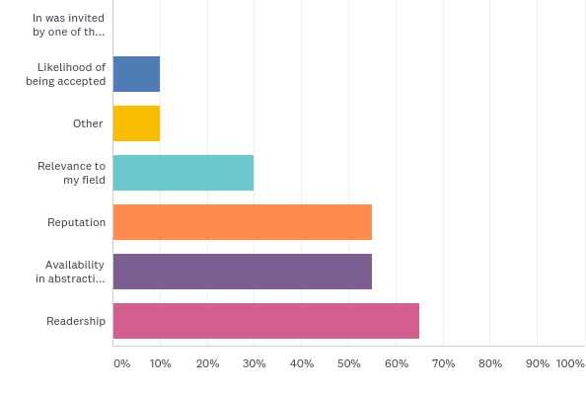
Q1: What were the reasons for you to submit your paper to the Ghana Medical Journal? Please tick the relevant boxes below.
Answered: 20 Skipped: 0

Slide 24
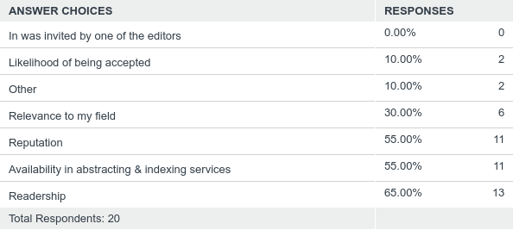
Q1: What were the reasons for you to submit your paper to the Ghana Medical Journal? Please tick the relevant boxes below.
Answered: 20 Skipped: 0

Slide 25
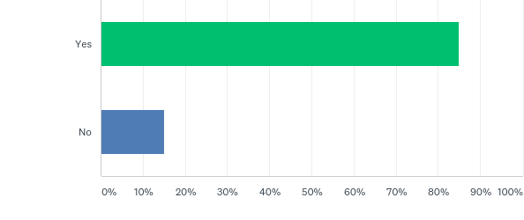
Q2: Was GMJ your first choice of journal for your article?
Answered: 20 Skipped: 0

Slide 26
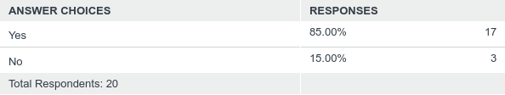
Q2: Was GMJ your first choice of journal for your article?
Answered: 20 Skipped: 0

Slide 27
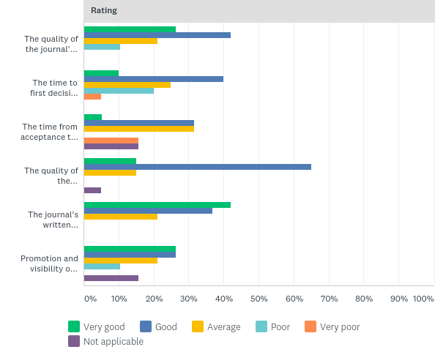
Q3: Based on your most recent experience with GMJ, how would you rate:
Answered: 20 Skipped: 0

Slide 28
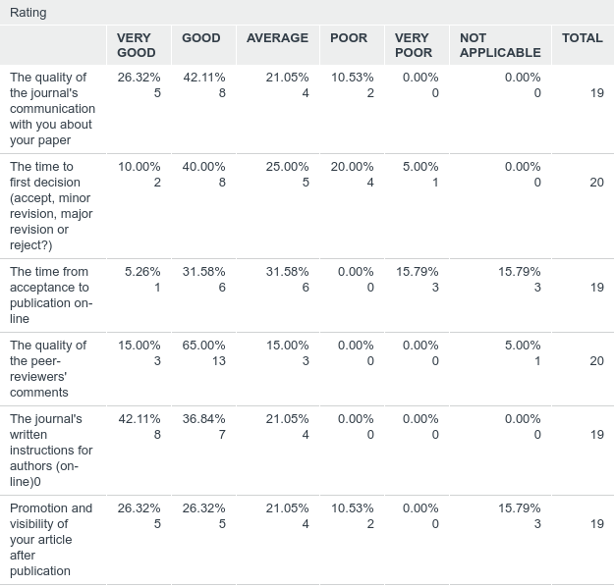
Q3: Based on your most recent experience with GMJ, how would you rate:
Answered: 20 Skipped: 0

Slide 29
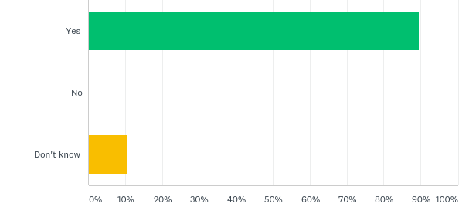
Q4: Based on your experience as an author would you submit another article if relevant to the journal's scope?
Answered: 19 Skipped: 1

Slide 30
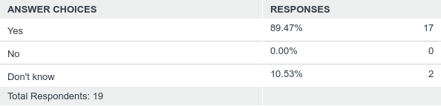
Q4: Based on your experience as an author would you submit another article if relevant to the journal's scope?
Answered: 19 Skipped: 1

Slide 31
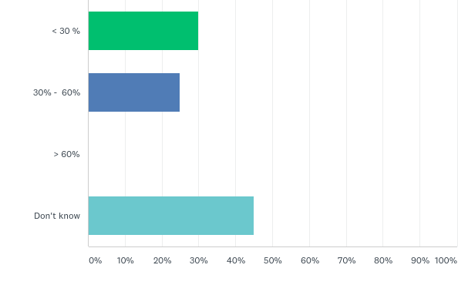
Q5: What percentage of your colleagues consult the journal on a regular basis?
Answered: 20 Skipped: 0

Slide 32
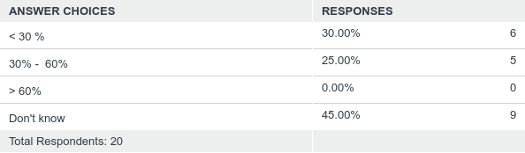
Q5: What percentage of your colleagues consult the journal on a regular basis?
Answered: 20 Skipped: 0

Slide 33
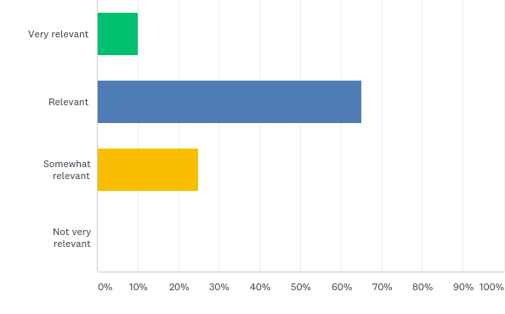
Q6: In general, how would you rate the relevance of papers to your clinical practice or medical research?
Answered: 20 Skipped: 0

Slide 34
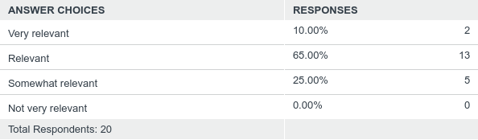
Q6: In general, how would you rate the relevance of papers to your clinical practice or medical research?
Answered: 20 Skipped: 0

Slide 35
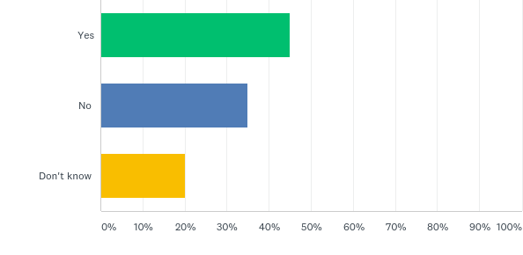
Q7: Has the relevance of the journal changed over the last few years?
Answered: 20 Skipped: 0

Slide 36
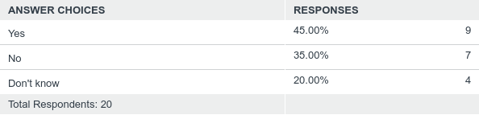
Q7: Has the relevance of the journal changed over the last few years?
Answered: 20 Skipped: 0

Slide 37
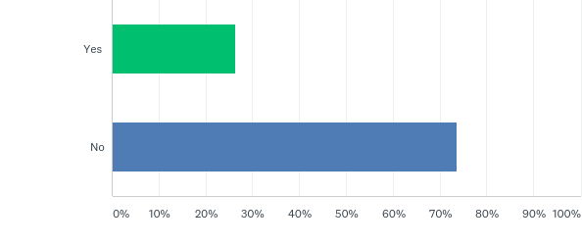
Q8: The Ghana Medical journal is publishing Editorial Commentaries, Original Research Papers, Special articles, Case reports in General Medicine. Do you feel specific articles types or disciplines are missing?
Answered: 19 Skipped: 1

Slide 38
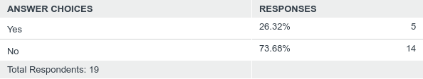
Q8: The Ghana Medical journal is publishing Editorial Commentaries, Original Research Papers, Special articles, Case reports in General Medicine. Do you feel specific articles types or disciplines are missing?
Answered: 19 Skipped: 1

Slide 39
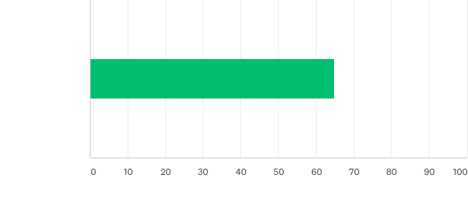
Q9: On a scale from 0 - 100 how would you rate the journal considering your responses below?
Answered: 19 Skipped: 1

Slide 40

Q9: On a scale from 0 - 100 how would you rate the journal considering your responses below?
Answered: 19 Skipped: 1

