Slide 1

How to Write
(Really Good) Review Articles
Christine Laine, MD, MPH
Editor-in-Chief, Annals of Internal Medicine

Slide 2
Overview
Types of reviews
Preparing reviews
  Selecting a topic
  Formulating good review questions
  Searching and selecting evidence
  Evaluating and synthesizing evidence
  Presenting the review

Slide 3
What is a Review Article?
Articles that summarize existing evidence rather than presenting new data (original research articles) or opinion (editorials, perspectives)
Authors search, select, and synthesize available evidence on a topic
Provide readers with a summary of a body of literature and draw conclusions
Refrain from statements/recommendations without supporting data

Slide 4
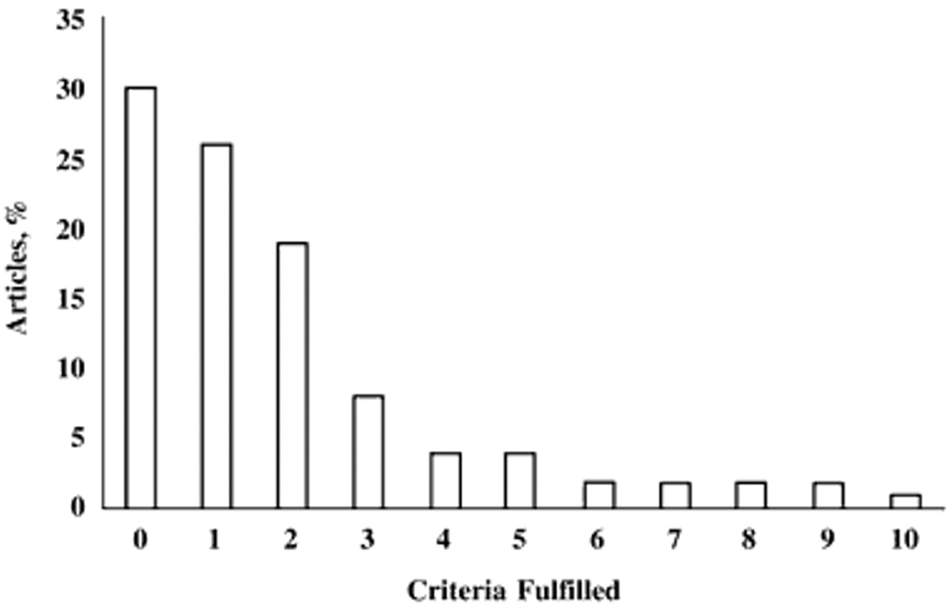

Percentage of 158 review articles published in 1996 that fulfilled specific methodologic criteria
McAlister, F. A. et. al. Ann Intern Med 1999;131:947-951

Slide 5
Types of Reviews
Feature | Narrative Review | Systematic Review | Meta-analysis
Question | Broad | Focused | Focused
Sources and Search | Not usually specified, potentially biased | Comprehensive sources, well-described search strategy | Comprehensive sources, well-described search strategy
Selection | Not usually specified, potentially biased | Criterion-based, uniformly applied | Criterion-based, uniformly applied
Appraisal of evidence | Quality of evidence often not rated | Rigorous, systematic rating of evidence using pre-specified criteria | Rigorous, systematic rating of evidence using pre-specified criteria
Synthesis | Distinction b/w evidence-based vs. opinion-based unclear | Evidence-based, qualitative | Evidence-based, qualitative AND quantitative

Slide 6
Narrative Reviews
Fragmentary evidence
Emerging clinical issue
Rare diseases
New technologies
Early insights about disease mechanisms, generate hypotheses

Slide 7
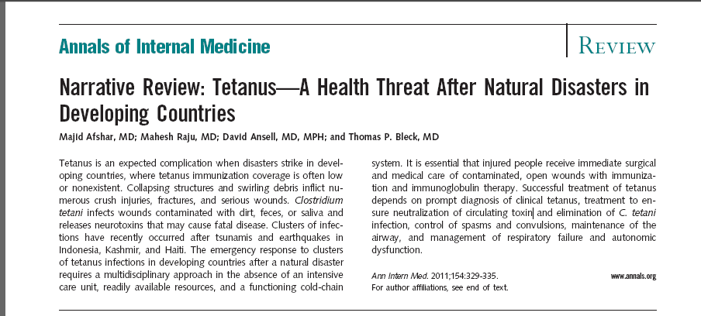

Slide 8
Systematic Reviews
Address focused questions
Well-described, rigorous approach to search and selection of evidence
Methodology described in sufficient detail such that readers could replicate it
Critical appraisal of included evidence using pre-specified criteria
Qualitative summary of evidence

Slide 9
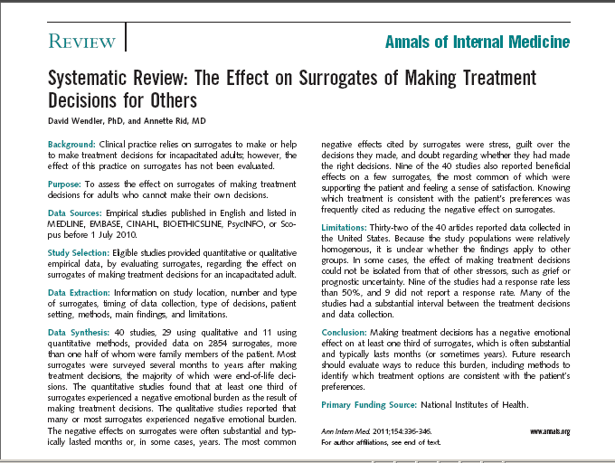

Slide 10
Meta-Analyses
Systematic reviews that use quantitative methods to summarize a body of evidence
Should carefully consider study heterogeneity before “meta-analyzing” them
Newer software has increased the use and misuse of meta-analysis

Slide 11
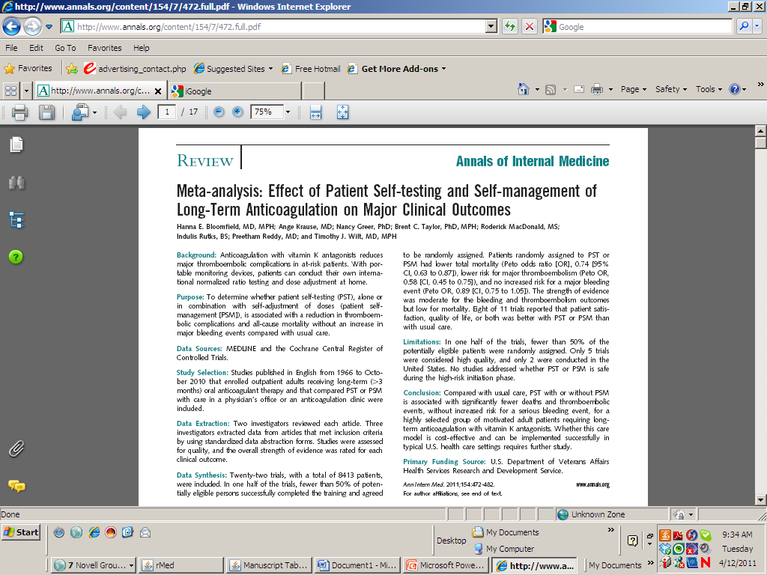

Slide 12

Choosing a Topic
What’s of interest to you?
What’s of interest to colleagues?
What hasn’t been reviewed recently?
Where are the newer developments?

Slide 13
Avoid topics…
…recently reviewed in a major journal
…where definitive studies are about to be completed
…where the evidence is thin
…very unfamiliar to you
…where evidence is available mostly in a language that you don’t speak
…of personal proprietary interest

Slide 14
Formulating the Question

Slide 15
Formulating The Question
Focus the question
  Populations
  Exposures/Interventions
  Comparisons
  Outcomes
OK to refine question in response to available evidence (but not in response to study results)

Slide 16
Population
Condition (definition, cause, stage severity, etc…)
Characteristics (age, sex, symptoms, comorbidities, etc…)
Setting (hospital, emergency department, nursing home, clinic, etc…)

Slide 17
Exposures or Interventions
Definition
Level or dose
Timing
Duration
Administration (intravenous v. oral, continuous v. intermittent, hospital v. home)

Slide 18
Comparisons
Exposure/risk factors
  Different exposure/risk factor
  Absence of exposure/risk factor
  Both
Intervention:
  Different active intervention
  No intervention
  Placebo

Slide 19
Outcomes
Clinical (death, non-fatal events, symptoms, quality of life,…)
Health care (health care use, cost,…)
Timing of outcome
Method of measurement

Slide 20
A “Non-Question”
Anticoagulants in stroke

Slide 21
Poorly Formulated Question
Intervention
Population
Are anticoagulants useful in patients who have had a stroke?

Slide 22
Well-Formulated Question
Intervention
Outcome
Do oral anticoagulants prevent recurrent stroke in
patients with acute ischemic stroke compared with no treatment?
Population
And
Clinical Condition
Comparison

Slide 23
Bloomfield et al. Meta-analysis: Effect of patient self-testing and self-management of long-term anticoagulation. Ann Intern Med. 2011:154:472-482.
Intervention
Does patient self-testing alone or with self-adjustment of dose thromboembolic complications/mortality/major bleeding compared with usual care in patients on long-term anticoagulation?
Outcomes
Comparison
Population

Slide 24
Searching for and Selecting Evidence

Slide 25
Plan the Search and Selection
Devise selection criteria that match the well-formulated question
Data sources
Date restrictions
Language restrictions
Types of evidence

Slide 26
Strategies for Finding Evidence
Devise selection criteria
Work with librarian
Develop search strategies
Pilot and revise search strategies
Aim for sensitivity not specificity
Develop screening strategy
Plan record keeping and archiving

Slide 27
Sources of Evidence
Electronic Bibliographic Databases
Manual searching of journals, conference proceedings, books
Reference lists of published studies, reviews
Study registries
Personal contact with experts, industry, public agencies
with researchers

Slide 28
Electronic Databases
MEDLINE, EMBASE, BIOSIS, CINHAL, PsychLit, CancerLit
Seems simpler than it is
Depending on topic and experience of searcher, MEDLINE search reveals only 32%-91% of relevant RCTs
Search for observational studies is tricky
Medical librarians can help

Slide 29
Type of Studies Included
Experimental vs. observational vs. both?
If experimental… RCTS vs. non-randomized? blinded vs. open?
If observational… prospective vs. retrospective case reports/series? Adjustment for confounders?

Slide 30
Identifying Unpublished Studies
Trials registries (Cochrane, Clinical Trials.gov, Controlled Trials)
Review of Proceedings of key conferences
Personal contact with researchers of published studies
Contacting industry and public agencies

Slide 31
Bloomfield et al. Meta-analysis: Effect of patient self-testing and self-management of long-term anticoagulation. Ann Intern Med. 2011:154:472-482.
Medline 2005-2010
2007 technology assessment report
English language
Randomized trials
Adult outpatients requiring oral anticoagulation for > 3months

Slide 32
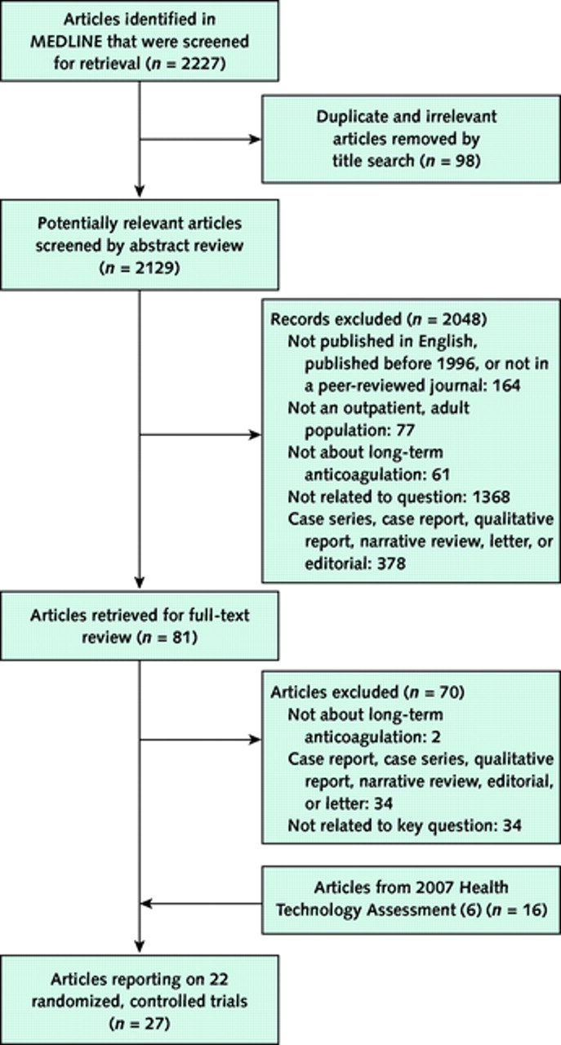
Summary of evidence search and selection.
Bloomfield H E et al. Ann Intern Med 2011;154:472-482
©2011 by American College of Physicians
Notes:
Summary of evidence search and selection.

Slide 33
Search and Selection Processes
Search multiple sources
Involve librarians if possible
At least 2 reviewers should independently review titles, abstracts, keywords for eligibility
Apply inclusion criteria using a standard form
Report & archive search strategy
Review authors with limited resources should select sources with highest yield, be sure that approach isn’t likely to miss important evidence on the topic
Acknowledge limitations of selected approach

Slide 34
Evaluating and Synthesizing Evidence
Amount
Type
Currency
Strength

Slide 35
Objectives of Evidence Appraisal
To understand the rigor of the studies to be included
To uncover reasons for differences among study results
To provide readers with sufficient information with which to judge the applicability of the review to their clinical practice

Slide 36
Steps in Evidence Appraisal
Decide which clinical and methodological study features are most relevant to study quality
Construct standardized appraisal forms
Develop a protocol for the collecting information on these features for each included study
Follow the protocol when reviewing each study

Slide 37
Factors that Contribute to Complexity of Evidence Synthesis
Heterogeneity of study populations
Diversity of exposures or diagnostic or intervention strategies
Diverse comparison groups
Heterogeneity of outcome measures
Diversity of study design and quality

Slide 38
Appraisal of Evidence
Strategies to minimize the potential for misclassification of study quality:
  Duplicate, independent examination of studies
  Blinding to study results and other identifying features of articles
  Correspondence with investigators to clarify issues

Slide 39
Evaluation and Synthesis of Evidence
 | Evaluation of Evidence | Synthesis of Evidence
Narrative review | Quality of evidence often not rated | Distinction b/w evidence-based vs. opinion-based unclear
Systematic review | Rigorous, systematic rating of evidence using pre-specified criteria | Qualitative synthesis considers quality of included evidence
Meta-analysis | Rigorous, systematic rating of evidence using pre-specified criteria | Quantitative analyses that weighs evidence according to study quality

Slide 40
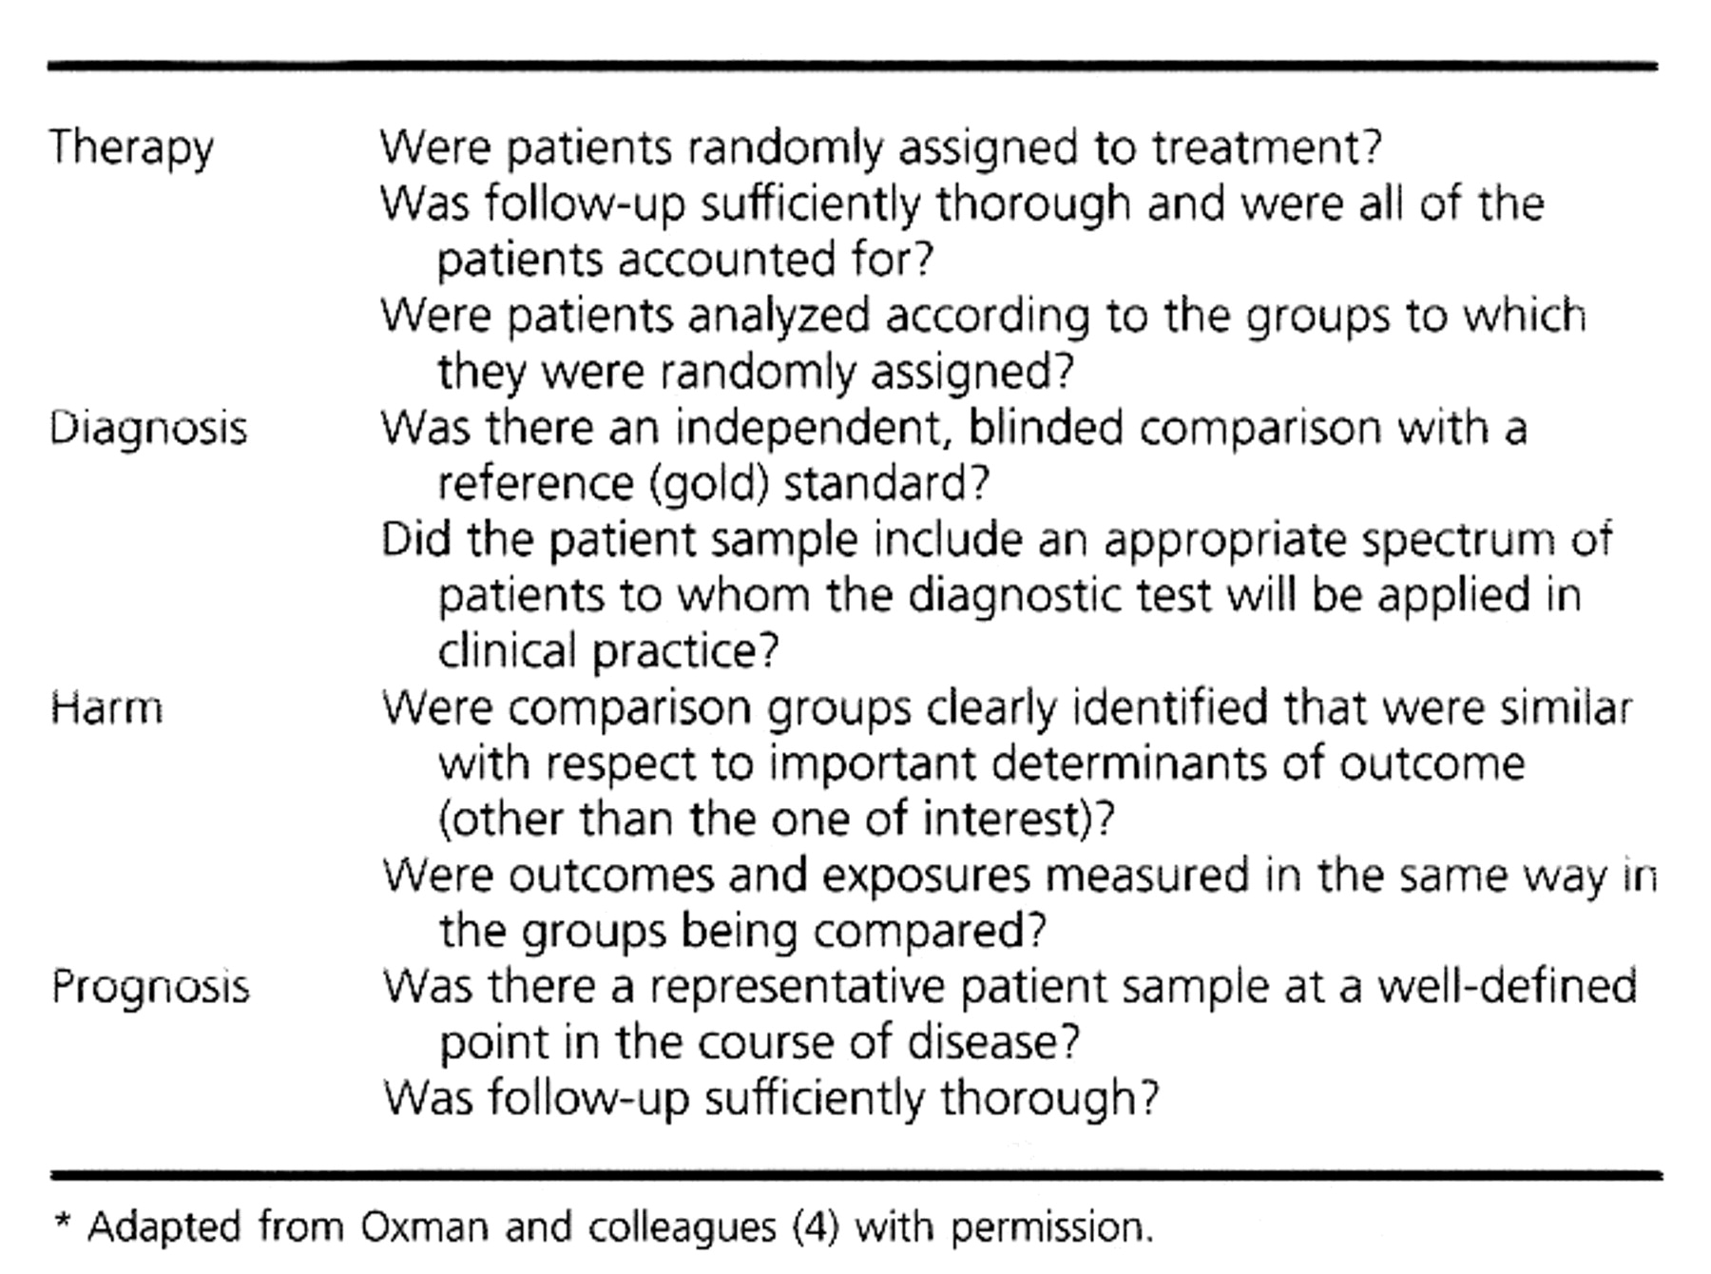
Abridged Checklist for Evaluating the Quality of Study Methods for Various Study Designs

Slide 41
Bloomfield et al. Meta-analysis: Effect of patient self-testing and self-management of long-term anticoagulation. Ann Intern Med. 2011:154:472-482.
Review authors assessed included trials for risk of bias:
  Allocation concealment
  Blinding
  Follow-up/missing data
  Intent-to-treat analysis
  Funding source

Slide 42
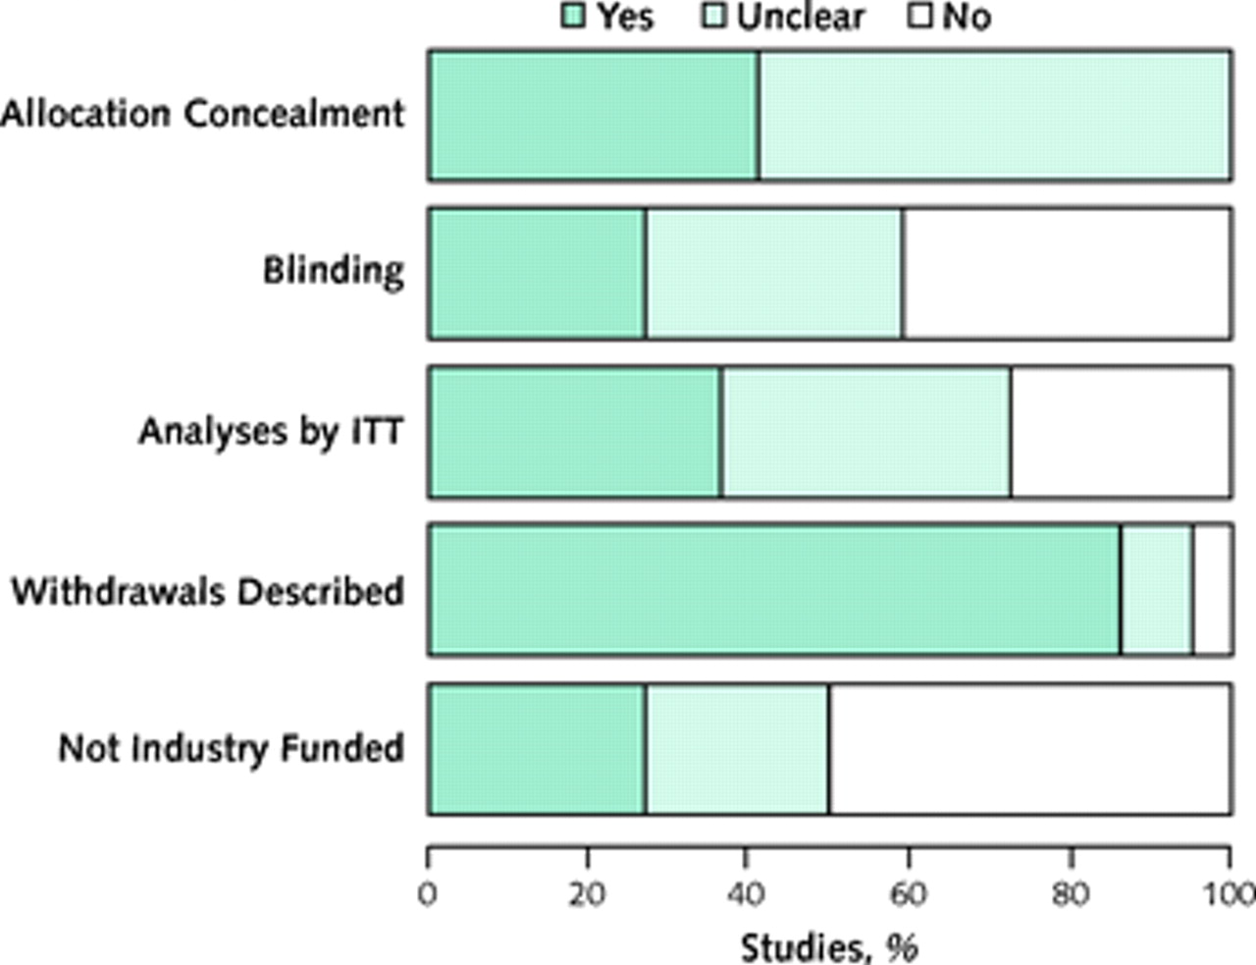
Risk for bias.ITT = intention-to-treat.
Bloomfield H E et al. Ann Intern Med 2011;154:472-482
©2011 by American College of Physicians
Notes:
Risk for bias.ITT = intention-to-treat.

Slide 43
Meta-Analysis: systematic reviews that use quantitative methods to summarize evidence
Evaluate the diversity (heterogeneity) among the results of different studies
Explore and try to explain the diversity
Fixed effect models assume that an intervention has a single true effect/ random effect models assume that effect varies
If heterogeneity is substantial, quantitative synthesis may be inappropriate and reviewers should refrain from meta-analysis

Slide 44
Synthesizing Evidence
Avoid merely listing results of individual studies
“Smith found no effect, while Jones and colleagues found a significant effect…”
Acknowledge and explain inconsistencies
“Smith studied a 10 mg/day in patients with stage 3 disease and found no effect compared to placebo, while Jones and colleagues studied a 30 mg/day in patients with stage 1 disease and found a significant effect compared to placebo…”

Slide 45
Presenting the Review

Slide 46
Introduction: Engage the Reader
Offer a sound rationale for the topic – clinical, educational, health care policy relevance
Comment on key prior reviews or syntheses
Tell us what this study will add
Present your objectives
Clearly define your outcome and exposure/risk
Don’t ramble on and on …………….

Slide 47
Methods: Give Detail
Describe the search strategy clearly
Languages
Types of studies such as only RCTs
Describe study selection process, who did what
Describe explicit inclusion and exclusion criteria
Describe criteria for rating quality of included studies
Flow sheet of study selection

Slide 48
Analysis: Rigorous and Consistent
Describe key data elements abstracted (outcome and exposure/predictors)
Evaluate methodological quality – and say how
Evaluate heterogeneity
Explain why if no meta-analysis
Evaluate publication bias

Slide 49
Results: Be Thoughful
Evidence tables - study design, subject characteristics, strengths, weakness of studies
Graphical summaries can be very helpful
Summarize, don’t just catalog findings of each included study
Comment on observed inconsistencies in available evidence, say how quality might affect results

Slide 50
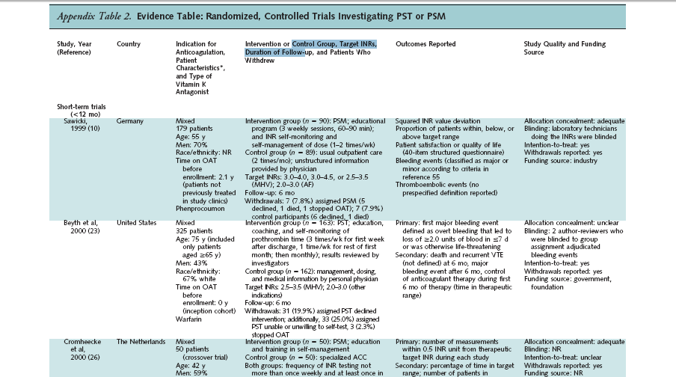

Slide 51
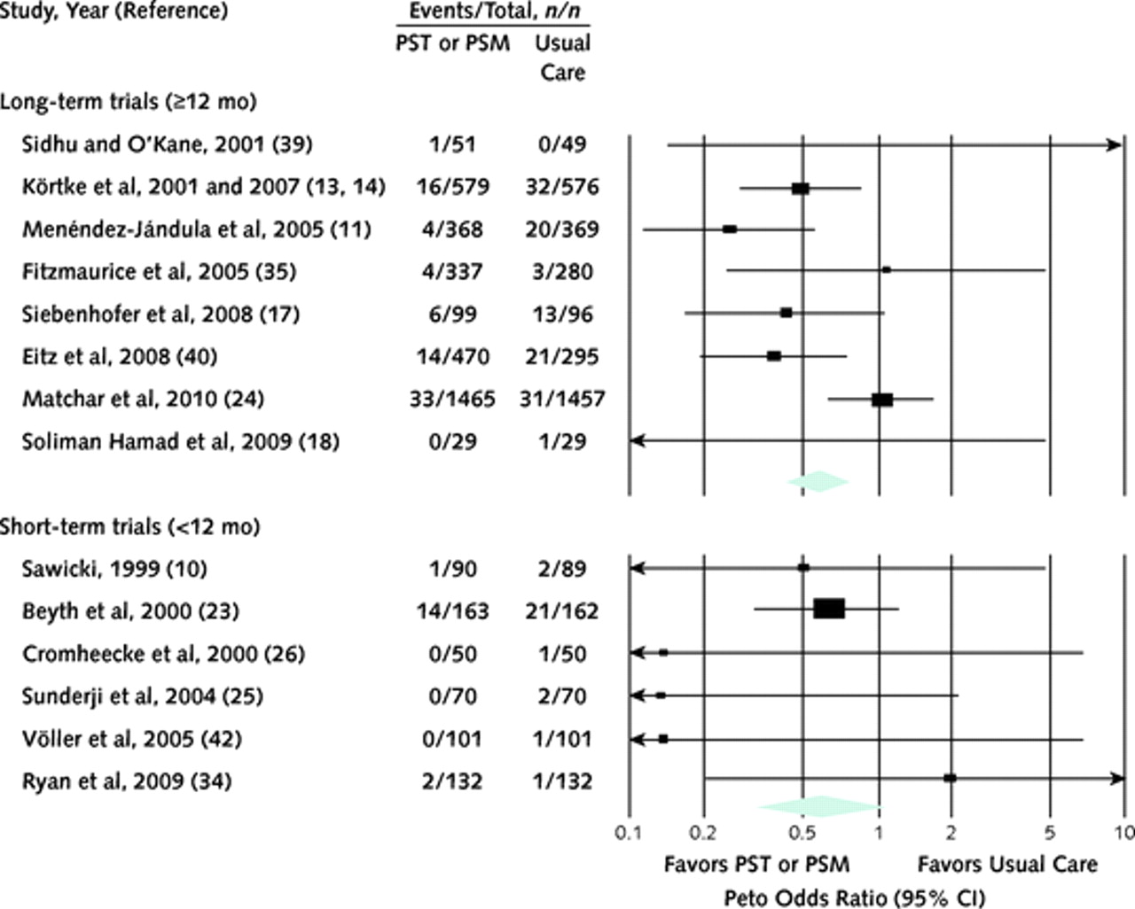
Major thromboembolic events in PST or PSM versus usual care studies.PSM = patient self-management; PST = patient self-testing.
Bloomfield H E et al. Ann Intern Med 2011;154:472-482
©2011 by American College of Physicians
Notes:
Major thromboembolic events in PST or PSM versus usual care studies.PSM = patient self-management; PST = patient self-testing.

Slide 52
Discussion
How results agree/disagree with prior literature (reviews)
Summarize relevance (e.g., clinical, educational, policy)
Where future research opportunities lie, from gaps identified
Limitations

Slide 53
10 Keys to successful reviews
1. Ask a good question and state it clearly
2. Clearly define inclusion criteria
3. Conduct a comprehensive search… of possible, involve a librarian
4. Rigorous critical appraisal of the quality of included evidence
5. Thoughtful qualitative summary of evidence
6. Refrain from quantitative summary unless homogeneity of available evidence permits pooling
7. If quantitatively pooling data, involve a statistician… early
8. Use the discussion to say what the review adds, acknowledge limitations, and discuss implications
9. Choose a journal that is a good fit and follow instructions
10. Avoid surprises that editors hate (conflicts, duplication, etc…)

